Slide 1


Roadway Intersections Database
Eric Green, PE, GISP
Jason Blackburn, PE
Lindsay Walker, PE, PTOE, AICP
09-07-16
Kentucky
Transportation
Center

Slide 2

Agenda
Development of the Database
  Background
  Database Description
  Safety Analysis
Reason for Planning Study
Planning Study Process
Wrap-up
  Current Project Status
  Issues and Limitations
  Additional Uses

Slide 3
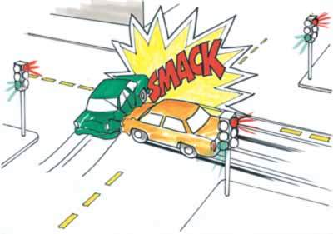
Background
Approximately 35 percent of all traffic crashes in Kentucky occur at intersections
There is a need to prioritize intersection crashes
Kentucky’s Highway Safety Improvement Program ranks these intersections
Crashes are not always properly located
  Lat/long or Linear Reference System

Slide 4
The New Methodology
Create a maintainable spatial intersection database
Use with SafetyAnalyst and Safety Performance Functions
Tied to KYTC’s node usage table (changes are propagated)
Dynamically linked to traffic volumes and road geometry
Other users: planning, maintenance, IT (not just safety)
Includes all roads (state and local)
Includes an area of influence

Slide 5
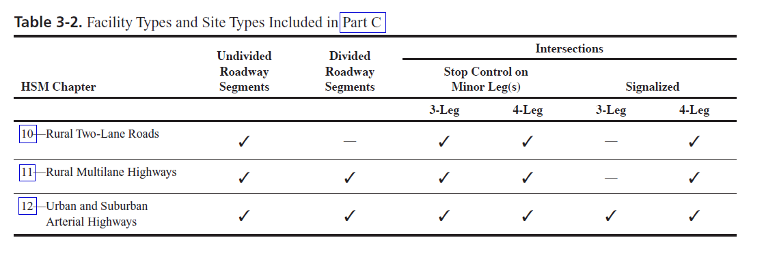
HSM Intersections

Slide 6
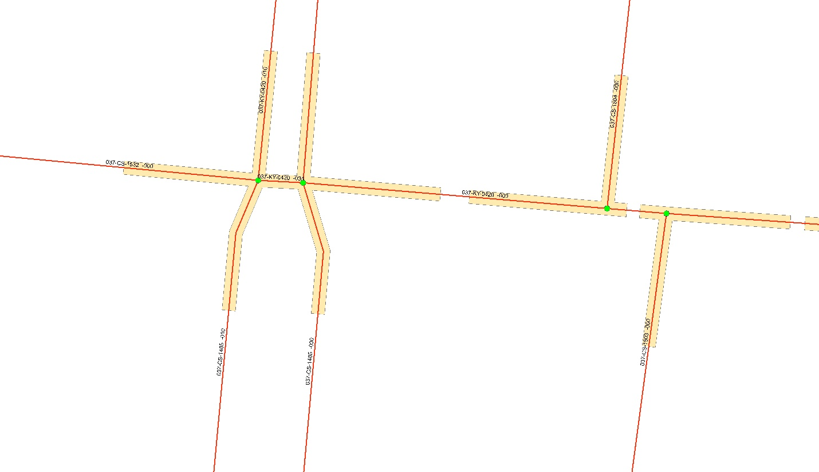
Merge or Not

Slide 7
Approach Counts
Count the number of s/e points for each unique route ID
Odd = 1 approach (route terminates)
Even = 2 approaches (route enters & exits)
Subsidiary Route-Type (NC, Y, Crossovers) = No approaches

Slide 8
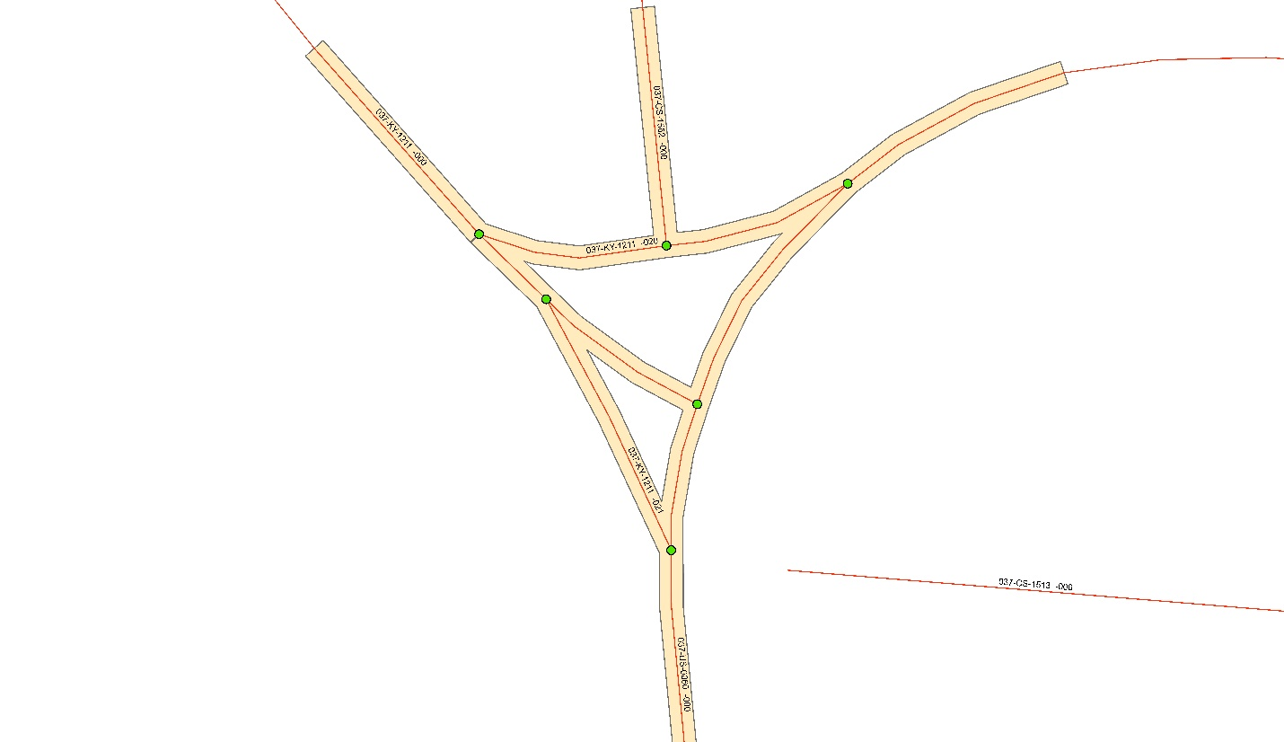
2
2
2
1
2
2
KY 1211 = 5, 1 approach
US 60 = 6, 2 approaches

Slide 9
Calculating Entering Traffic
If TYPE_OP = 1 and Knu_S_E = ‘S’, entering traffic = LAST_COUNT*1
If TYPE_OP = 1 and Knu_S_E = ‘E’, entering traffic = LAST_COUNT*0
If TYPE_OP = 2 or TYPE_OP = D, entering traffic = LAST_COUNT*0.5

Slide 10
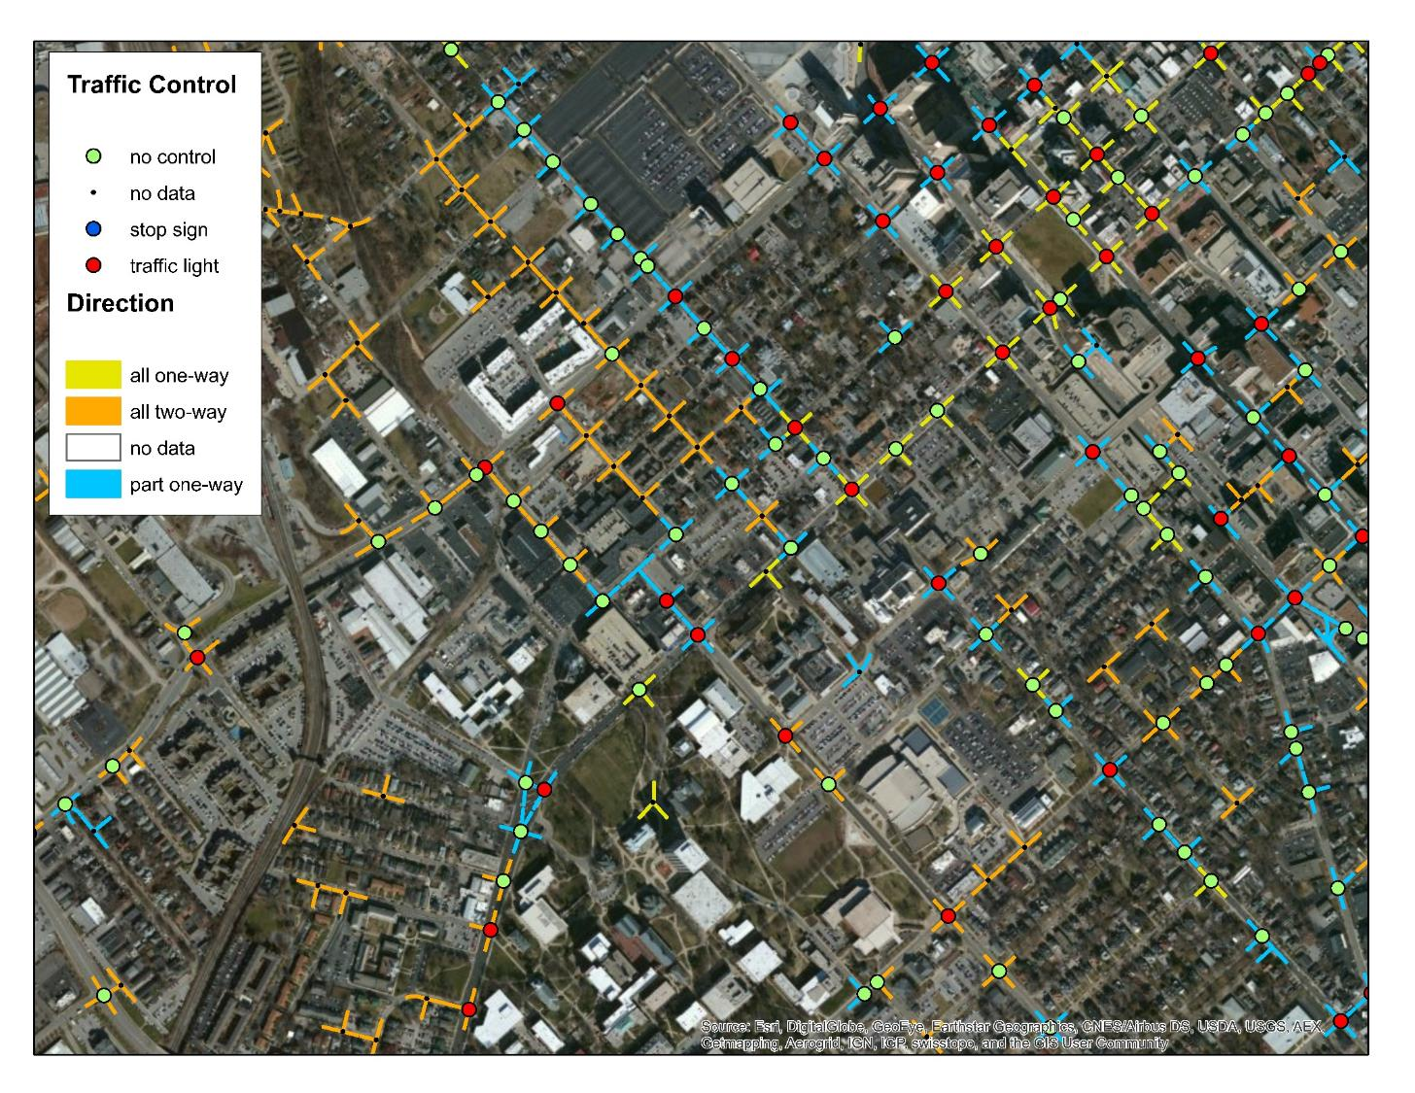
Mapping the Results

Slide 11
Type | Code | Description | Count
1 | U3rF | undivided 3-leg rural full stop | 78
2 | U3rP | undivided 3-leg rural (at least) partial stop | 37256
3 | U3rS | undivided 3-leg rural signal | 96
4 | U3uF | undivided 3-leg urban full stop | 68
5 | U3uP | undivided 3-leg urban (at least) partial stop | 10252
6 | U3uS | undivided 3-leg urban signal | 583
7 | U4rF | undivided 4+ leg rural full stop | 77
8 | U4rP | undivided 4+ leg rural (at least) partial stop | 4202
9 | U4rS | undivided 4+ leg rural signal | 166
10 | U4uF | undivided 4+ leg urban full stop | 89
11 | U4uP | undivided 4+ leg urban (at least) partial stop | 2484
12 | U4uS | undivided 4+ leg urban signal | 1492
13 | D3rP | divided 3-leg rural (at least) partial stop | 729
14 | D3rS | divided 3-leg rural signal | 26
15 | D3uP | divided 3-leg urban(at least) partial stop | 1292
16 | D3uS | divided 3-leg urban signal | 335
17 | D4rP | divided 4+ leg rural (at least) partial stop | 459
18 | D4rS | divided 4+ leg rural signal | 66
19 | D4uP | divided 4+ leg urban(at least) partial stop | 560
20 | D4uS | divided 4+ leg urban signal | 832

Slide 12
Safety Analysis

Slide 13
Intersection Priority List
Need to rank all intersections by a safety factor
Replace the traditional and inadequate Critical Rate method
  Regression-to-the-mean
  Relationship between AADT and crashes
Employ state-of-the-art methodologies of the Highway Safety Manual

Slide 14

Regression To The Mean
U.S. Department of Transportation
Federal Highway Administration
  Sir Francis Galton, 1887
    Sweet pea seed size in successive generations
Mean

Slide 15
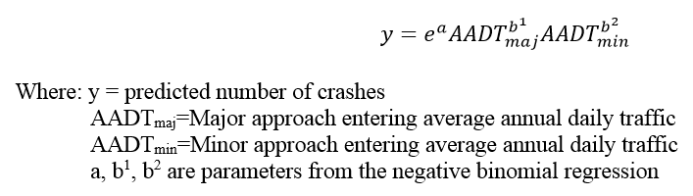
Safety Performance Function

Slide 16
Model Development
20 SPFs developed for each intersection type
Each model included SPFs for all and KAB crashes
SPFs and observed crashes were used to calculate a new measure of safety…

Slide 17
Potential for Crash Reduction
Crashes per year
Observed Crashes
EB Crashes (Corrected)
PCR
Predicted Crashes from SPF
AADT
Notes:
Note that all of for specific site

Slide 18
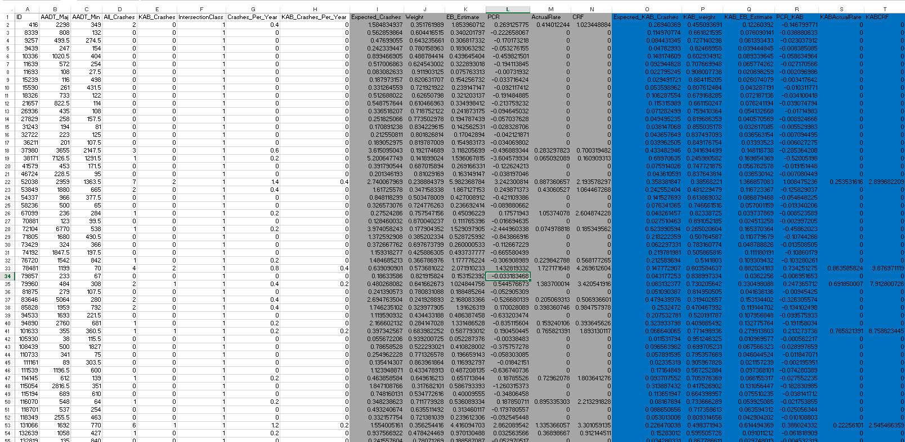
Sort by PCR
Filter by county or District
Calculate the PCR for a new intersection using SPF

Slide 19
Reason For Study
(Jason rambles on for a couple of minutes.)

Slide 20
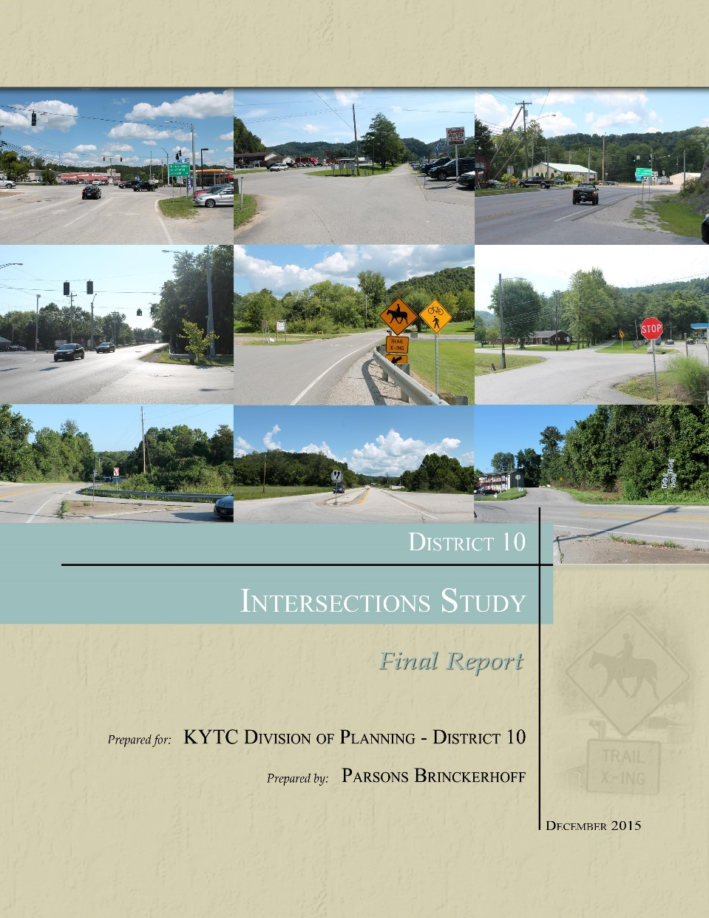
District 10 Intersections Study

Slide 21
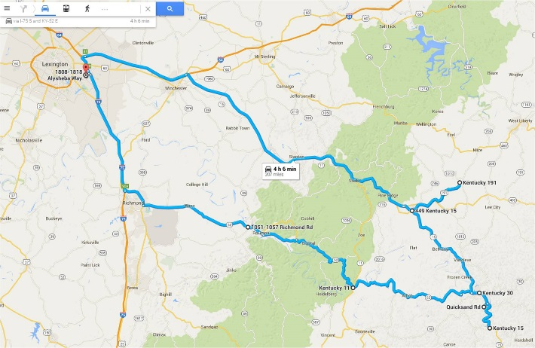
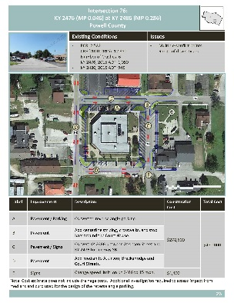
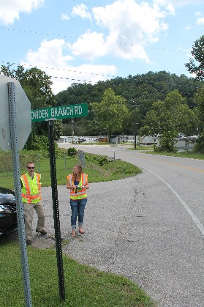
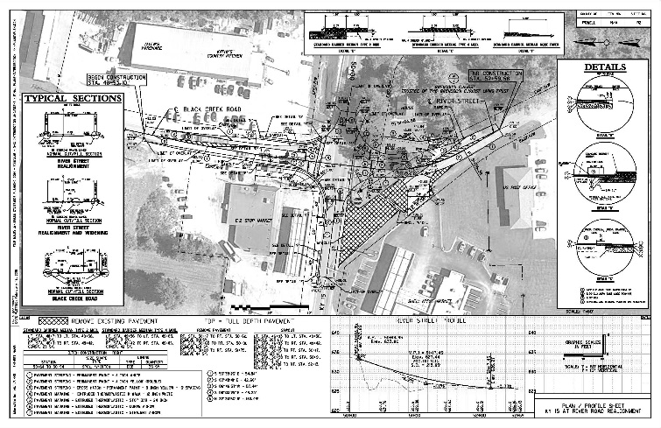
Study Components
Existing Conditions
  Intersection Geometry
  Manner of Collision
  Traffic Volumes
Improvement Development
  HSIP Funded Projects (<$500,000)
  PIF Projects
  Short-Term Line Items
Cost Estimation
Documentation
Contract Ready Plans

Slide 22
Purpose and Need
Purpose
  To identify potential improvements at 50 identified intersections throughout KYTC District 10.
Need
  Sight Distance Issues
  Multiple Access Points
  Signage and Striping
Goals and Objectives
  Improvement options that address identified safety issues
  Construction quantities and cost estimates
  Solutions that are less than $500,000 where possible

Slide 23
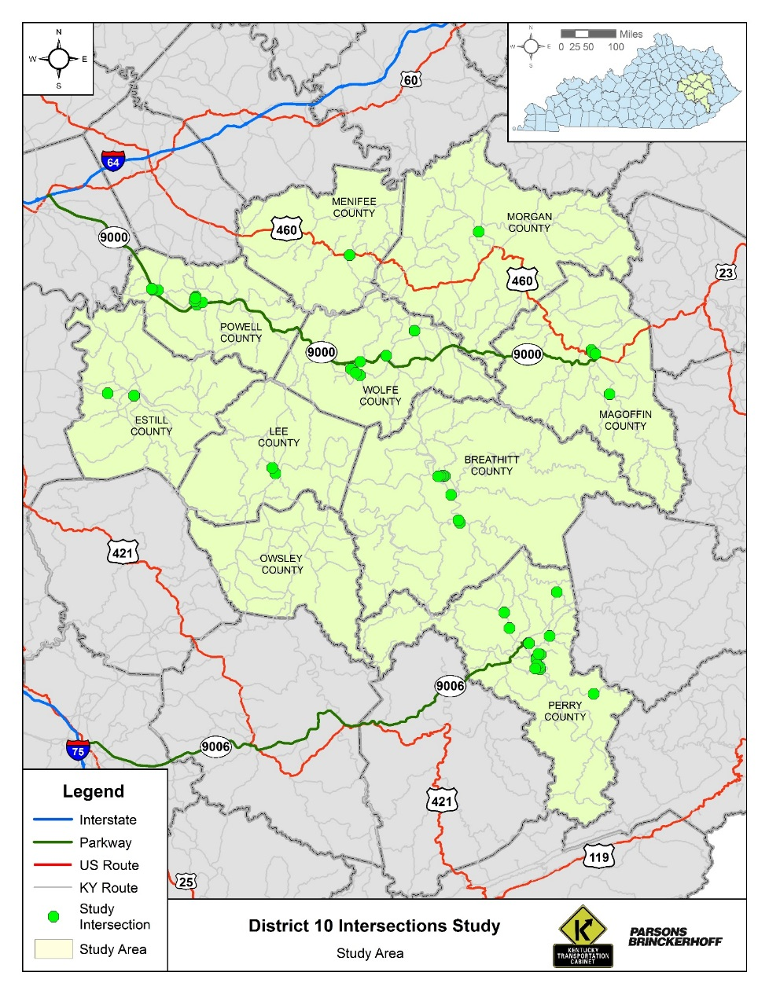
Study Area

Slide 24
Terms
Critical rate factor (CRF)
  Crash rate for a spot or segment divided by the critical crash rate
KAB
  Injury scale
    K = Fatal
    A = Incapacitating Injury
    B = Non-incapacitating Injury
Potential Crash Reduction (PCR)
  Estimate of crash frequency reduction

Slide 25
Intersections
Top 5 have highest fatality and injury collision rate (KAB)
Next 41 ranked in order by PCR
Last 4 were identified as locations with safety issues by the District

Slide 26
Crash Rates

Slide 27
Improvement Categories
Signage & Striping: 30
Sight Distance: 9
Delineation: 14
Traffic Signals: 5
Turn Lanes: 13
Access Management: 25
Realignment: 19

Slide 28
Improvement Considerations
Adjacent Intersections
  Consistent Typical Section
  Consistent Speed
Access Management Study
Multiple Options
Line Items for Individual Improvements

Slide 29
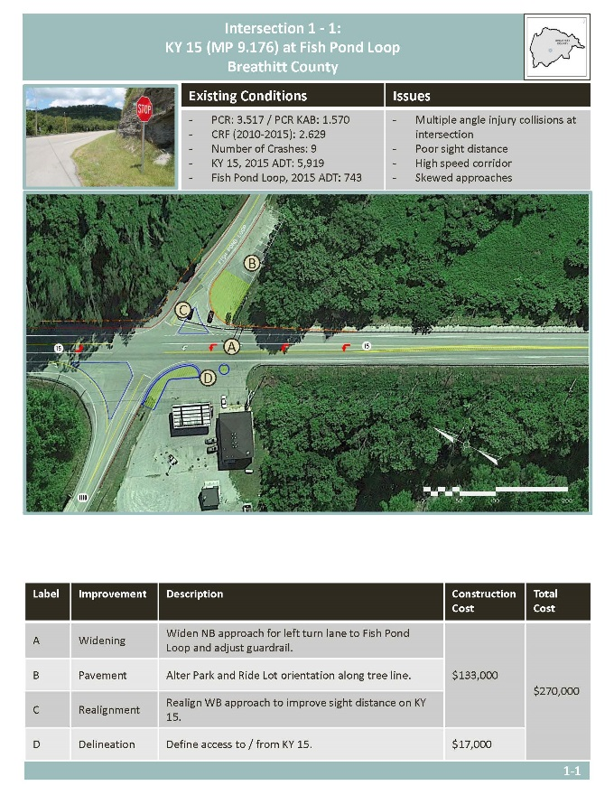
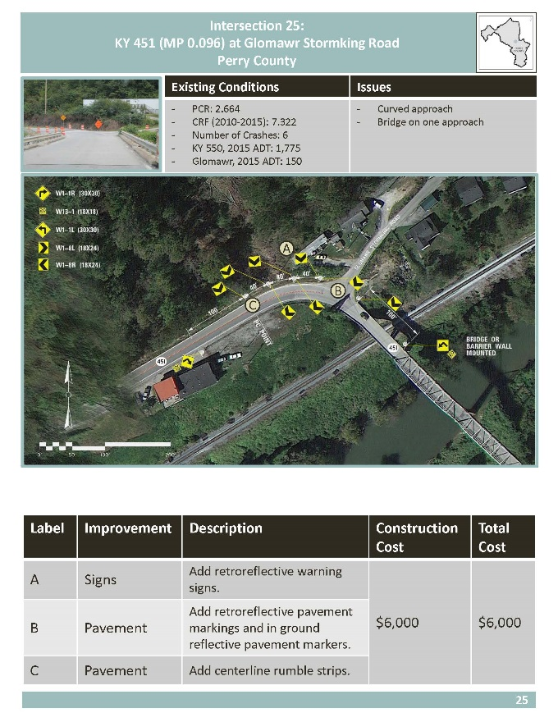
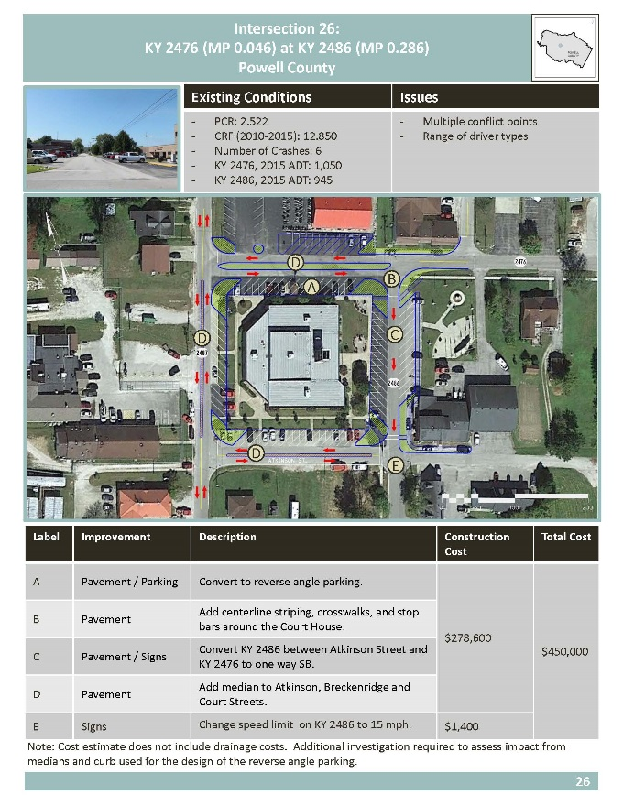
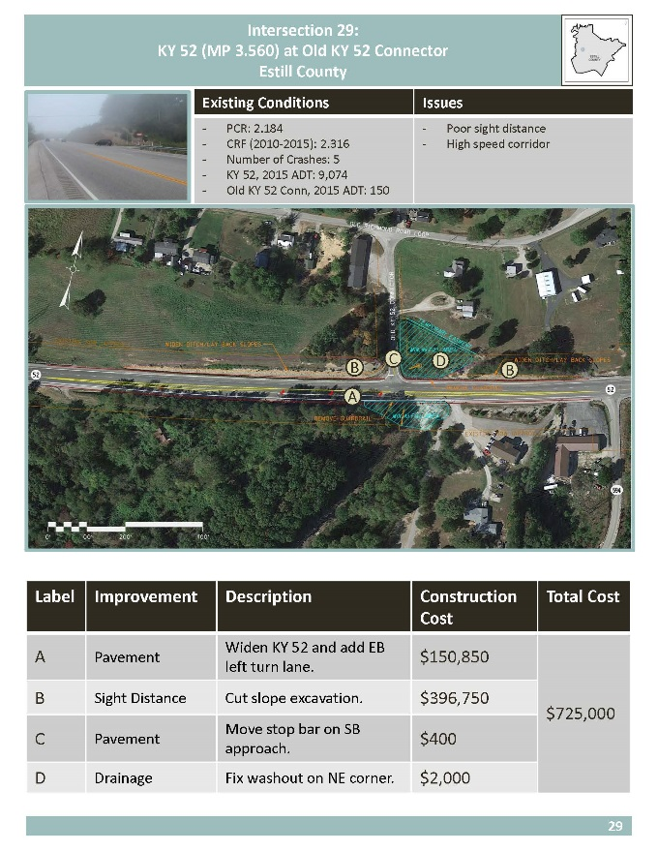
Example Projects

Slide 30
Project Cost Distribution
Projects < $500,000
33
Projects > $500,000
17 May Require PIF
6 Have Options < $500,000

Slide 31
Additional Study Components
Crash Distribution
Signal Warrant Analysis
Detailed Cost Estimates
Standard Drawings

Slide 32
Summary Table
County | Intersection # | Cross Streets | Treatments |  |  | Design | Right-of-Way | Utilities | Construction | Total Cost
Magoffin | 36-2 | KY 40 at Coal Branch Road | A | Realignment | Shift intersection away from building to improve sight distance. | $50,000 | $48,000 | $25,000 | $81,600 | $205,000
 |  |  | B | Widening | Widen Coal Branch Road.
 |  |  | C | Signs | Install "No Parking" signs (R8-3a) in front of the bank on KY 40. | N/A |  |  | $400
Magoffin | 36-3 | KY 40 at Coal Branch Road | A | Signs | Sign Coal Branch Road to be one-way. | $50,000 | $75,000 | $15,000 | $109,600 | $250,000
 |  |  | B | Realignment | Widen and realign Flint Street and Higgin Street to accommodate new traffic pattern.
 |  |  | C | Signs | Install "No Parking" signs (R8-3a) in front of the bank on KY 40. | N/A |  |  | $400
Breathitt | 37-1 | KY 15 at Thorpe Road | A | Pavement | Add full lane rumble strips to slow vehicles through curve. | $50,000 | $55,000 | $15,000 | $360,000 | $480,000
 |  |  | B | Sight Distance | Improve sight distance with slope removal near corner of Thorpe Road.
Breathitt | 37-2 | KY 15 at Thorpe Road | A | Pavement | Add new roadway between Thorpe Road and Fish Pond Loop. | $50,000 | $300,000 | $25,000 | $180,000 | $555,000
 |  |  | B | Access Management | Close Thorpe Road and access points between Thorpe Road and Fish Pond Loop.
Menifee | 38-1 | US 460 at KY 746 | A | Delineation | Add delineators to require utilization of the center turn lane. | $50,000 | $0 | $10,000 | $45,300 | $106,000
 |  |  | B | Pavement | Add left turn receiving pocket on US 460.
 |  |  | C | Pavement | Paint stop bar on KY 746. | N/A |  |  | $700
Menifee | 38-2 | US 460 at KY 746 | A | Access Management | Close access points on east side of US 460. | $50,000 | $0 | $10,000 | $13,300 | $74,000
 |  |  | B | Pavement | Paint stop bar on KY 746. | N/A |  |  | $700
Wolfe | 39 - 1 | KY 15 at Swift Camp Creek | A | Pavement | Add SB left turn pocket. | $200,000 | $0 | $10,000 | $761,000 | $1,090,000
 |  |  | B | Access Management | Realign Swift Camp Creek Road. | $50,000 |  |  | $69,000
Wolfe | 39 - 2 | KY 15 at Swift Camp Creek | A | Access Management | Close road access and provide driveway for resident only. | $50,000 | $0 | $0 | $35,000 | $85,000
Perry | 40 - 1 | KY 15 at Scuddy Mountain Rd. | A | Pavement | Install Stop signs and stop bar on driveways. | N/A | $0 | $10,000 | $3,100 | $250,000
 |  |  | B | Pavement | Re-stripe dedicated left turn lanes on KY 15. | N/A |  |  | $39,100
 |  |  | C | Pavement | Improve access for Scuddy Branch Road. | $50,000 |  |  | $147,800
Perry | 40 - 2 | KY 15 at Scuddy Mountain Rd. | A | Pavement | Install stop signs and stop bar on driveways. | N/A | $10,000 | $15,000 | $3,100 | $305,000
 |  |  | B | Pavement | Re-stripe dedicated left turn lanes on KY 15. | N/A |  |  | $39,400
 |  |  | C | Pavement | Change access to Scuddy Mountain Road from Scuddy Branch Road. | $50,000 |  |  | $187,500
Wolfe | 41 | KY 191 at KY 746 | A | Sight Distance | Trim trees inside of curve on KY 191. | N/A | $10,000 | $25,000 | $2,700 | $295,000
 |  |  | B | Realignment | Realign for 90 degree intersection. | $50,000 |  |  | $207,300
 |  |  | C | Realignment | Extend driveway to access center of the curve.
Perry | 42 | KY 476 at KY 1146 | A | Signs | Move stop sign on KY 1146 closer to intersection. | N/A | $0 | $35,000 | $800 | $335,000
 |  |  | B | Pavement | Add stop bar on KY 1146. | N/A |  |  | $700
 |  |  | C | Delineation | Delineate KY 476 from parking area. | $50,000 |  |  | $248,500
Link

Slide 33
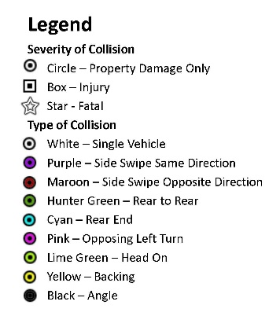
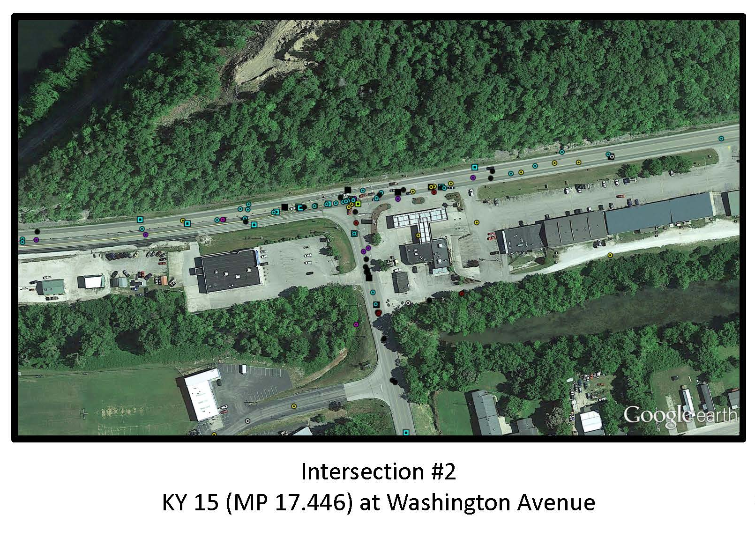
Crash Distribution

Slide 34
Detailed Cost Estimates
ITEM | BID CODE | UNIT | UNIT PRICE | INT1 |  | INT1 |  | INT1 |  | INT1
 |  |  |  |  |  | OPTION 1-D (ACCESS) |  | OPTION 2 |  | OPTION 2-D (ACCESS)
 |  |  |  | QUANTITY | TOTAL | QUANTITY | TOTAL | QUANTITY | TOTAL | QUANTITY | TOTAL
DGA BASE | 00001 | TON | $20.00 | 63 | $1,259.25 | 0 | $0.00 | 226 | $4,520.11 | 76 | $1,527.20
CEMENT STABILIZED ROADBED | 00008 | SQ YD | $3.00 | 0 | $0.00 | 0 | $0.00 | 0 | $0.00 | 0 | $0.00
DRAINAGE BLANKET-TYPE II-ASPH | 00018 | TON | $43.00 | 0 | $0.00 | 0 | $0.00 | 0 | $0.00 | 0 | $0.00
ASPHALT SEAL AGGREGATE | 00100 | TON | $95.00 | 2 | $228.00 | 0 | $0.00 | 5 | $457.27 | 0 | $0.00
REMOVE CONCRETE MEDIAN | 23839EC | SQ YD | $47.00 | 0 | $0.00 | 0 | $0.00 | 0 | $0.00 | 0 | $0.00
RELOCATE LIGHT POLE | 23836EC | EACH | $4,000.00 | 0 | $0.00 | 0 | $0.00 | 0 | $0.00 | 0 | $0.00
SAW CUT | 20430ED | LF | $3.40 | 630 | $2,142.00 | 400 | $1,360.00 | 400 | $1,360.00 | 400 | $1,360.00
THERMO RUMBLE STRIPS TY 2 | 24097EC | LF | $30.00 | 0 | $0.00 | 0 | $0.00 | 0 | $0.00 | 0 | $0.00
DOUBLE 4' X 4' RCBC | N/A | LF | $460.00 | 0 | $0.00 | 0 | $0.00 | 0 | $0.00 | 0 | $0.00
6X5 BOX CULVERT | N/A | LF | $400.00 | 0 | $0.00 | 0 | $0.00 | 0 | $0.00 | 0 | $0.00
EXTEND 10X6 BOX CULVERT | N/A | LF | $1,400.00 | 0 | $0.00 | 0 | $0.00 | 0 | $0.00 | 0 | $0.00
10X6 BOX CULVERT HDWL | N/A | EACH | $7,500.00 | 0 | $0.00 | 0 | $0.00 | 0 | $0.00 | 0 | $0.00
REDI ROCK/STRONG TIE RETAINING WALL | N/A | EACH | $45.00 | 0 | $0.00 | 0 | $0.00 | 0 | $0.00 | 0 | $0.00
NEW LIGHTED INTERSECTION | N/A | EACH | $65,000.00 | 0 | $0.00 | 0 | $0.00 | 0 | $0.00 | 0 | $0.00
PERMANENT DRAINAGE EASEMENT |  | ACRES |  | 0 |  | 0 |  | 0 |  | 0
RIGHT OF WAY |  | ACRES |  | 0.135 |  | 0 |  | 0.233 |  | 0.233
TEMPORARY EASEMENT |  | SQ FT
 |  |  | CONSTRUCTION COSTS SUBTOTAL: |  | $4,000 |  | $2,000 |  | $7,000 |  | $3,000
MOBILIZATION (ROUNDED UP TO $1000) | 02568 | LS | 3% |  | $1,000 |  | $1,000 |  | $1,000 |  | $1,000
DEMOBILIZATION (ROUNDED UP TO $1000) | 02569 | LS | 1.50% |  | $1,000 |  | $1,000 |  | $1,000 |  | $1,000
 |  |  | SUBTOTAL: |  | $6,000 |  | $4,000 |  | $9,000 |  | $5,000
 |  |  | CONTINGENCY (20%): |  | $2,000 |  | $1,000 |  | $2,000 |  | $1,000
 |  |  | TOTAL: |  | $10,000 |  | $5,000 |  | $20,000 |  | $6,000
Link

Slide 35
Detailed Cost Estimates
ITEM | BID CODE | UNIT | UNIT PRICE | INT1 |  | INT1 |  | INT1 |  | INT1
 |  |  |  |  |  | OPTION 1-D (ACCESS) |  | OPTION 2 |  | OPTION 2-D (ACCESS)
 |  |  |  | QUANTITY | TOTAL | QUANTITY | TOTAL | QUANTITY | TOTAL | QUANTITY | TOTAL
DGA BASE | 00001 | TON | $20.00 | 63 | $1,259.25 | 0 | $0.00 | 226 | $4,520.11 | 76 | $1,527.20
CEMENT STABILIZED ROADBED | 00008 | SQ YD | $3.00 | 0 | $0.00 | 0 | $0.00 | 0 | $0.00 | 0 | $0.00
DRAINAGE BLANKET-TYPE II-ASPH | 00018 | TON | $43.00 | 0 | $0.00 | 0 | $0.00 | 0 | $0.00 | 0 | $0.00
ASPHALT SEAL AGGREGATE | 00100 | TON | $95.00 | 2 | $228.00 | 0 | $0.00 | 5 | $457.27 | 0 | $0.00
REMOVE CONCRETE MEDIAN | 23839EC | SQ YD | $47.00 | 0 | $0.00 | 0 | $0.00 | 0 | $0.00 | 0 | $0.00
RELOCATE LIGHT POLE | 23836EC | EACH | $4,000.00 | 0 | $0.00 | 0 | $0.00 | 0 | $0.00 | 0 | $0.00
SAW CUT | 20430ED | LF | $3.40 | 630 | $2,142.00 | 400 | $1,360.00 | 400 | $1,360.00 | 400 | $1,360.00
THERMO RUMBLE STRIPS TY 2 | 24097EC | LF | $30.00 | 0 | $0.00 | 0 | $0.00 | 0 | $0.00 | 0 | $0.00
DOUBLE 4' X 4' RCBC | N/A | LF | $460.00 | 0 | $0.00 | 0 | $0.00 | 0 | $0.00 | 0 | $0.00
6X5 BOX CULVERT | N/A | LF | $400.00 | 0 | $0.00 | 0 | $0.00 | 0 | $0.00 | 0 | $0.00
EXTEND 10X6 BOX CULVERT | N/A | LF | $1,400.00 | 0 | $0.00 | 0 | $0.00 | 0 | $0.00 | 0 | $0.00
10X6 BOX CULVERT HDWL | N/A | EACH | $7,500.00 | 0 | $0.00 | 0 | $0.00 | 0 | $0.00 | 0 | $0.00
REDI ROCK/STRONG TIE RETAINING WALL | N/A | EACH | $45.00 | 0 | $0.00 | 0 | $0.00 | 0 | $0.00 | 0 | $0.00
NEW LIGHTED INTERSECTION | N/A | EACH | $65,000.00 | 0 | $0.00 | 0 | $0.00 | 0 | $0.00 | 0 | $0.00
PERMANENT DRAINAGE EASEMENT |  | ACRES |  | 0 |  | 0 |  | 0 |  | 0
RIGHT OF WAY |  | ACRES |  | 0.135 |  | 0 |  | 0.233 |  | 0.233
TEMPORARY EASEMENT |  | SQ FT
 |  |  | CONSTRUCTION COSTS SUBTOTAL: |  | $4,000 |  | $2,000 |  | $7,000 |  | $3,000
MOBILIZATION (ROUNDED UP TO $1000) | 02568 | LS | 3% |  | $1,000 |  | $1,000 |  | $1,000 |  | $1,000
DEMOBILIZATION (ROUNDED UP TO $1000) | 02569 | LS | 1.50% |  | $1,000 |  | $1,000 |  | $1,000 |  | $1,000
 |  |  | SUBTOTAL: |  | $6,000 |  | $4,000 |  | $9,000 |  | $5,000
 |  |  | CONTINGENCY (20%): |  | $2,000 |  | $1,000 |  | $2,000 |  | $1,000
 |  |  | TOTAL: |  | $10,000 |  | $5,000 |  | $20,000 |  | $6,000
Link
Notes:
-No Site Specific Surveys
-Do not include environmental permits, mitigation, fees and other associated costs such as geotechnical analysis

Slide 36
Standard Drawings
Link

Slide 37
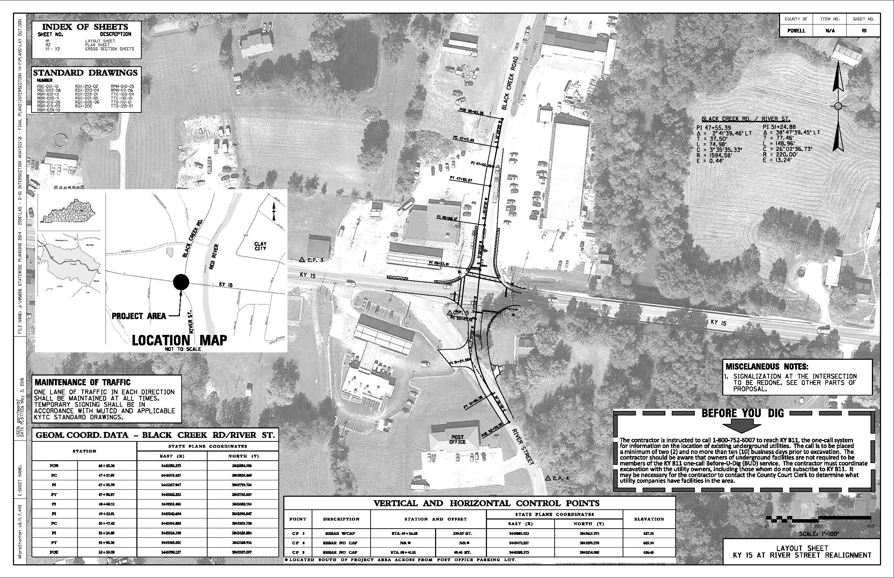
Contract Ready Documents

Slide 38
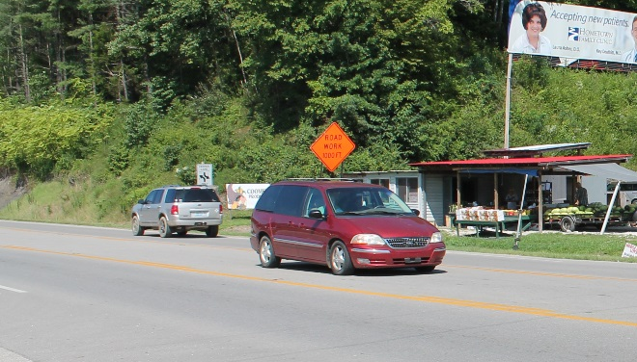
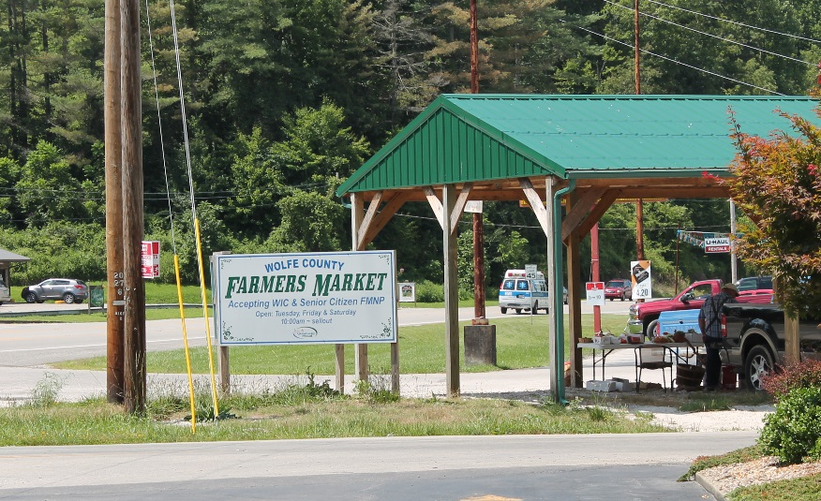
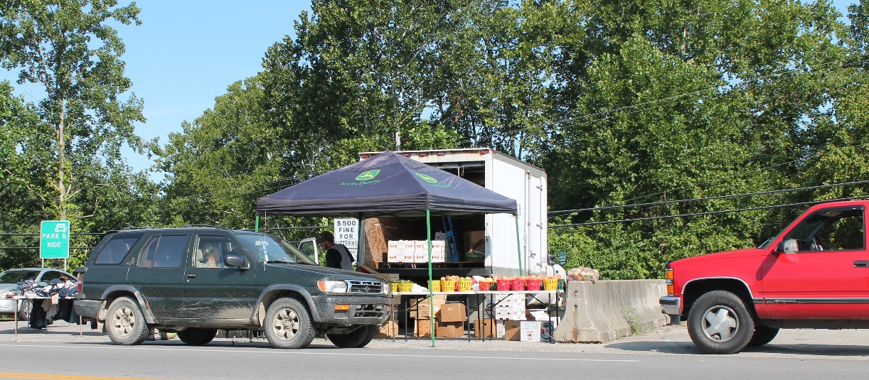
Consultant Lessons Learned
Need Crash Records
Location of Crashes
District Preferences
Involvement of Agencies / Divisions
Notes:
Just joking – don’t allow farmer’s markets near intersections – seems like this was a recurring them at many of the identified intersections.

Slide 39
Current Project Status
9 of 50 have been advanced to some degree
  1 Completed
  2 Under Construction
  1 In Right of Way/Utilities
  5 In Design
  PCR for Current Projects = 70.1
  Projected Total Costs = $2 million

Slide 40
Current Issues and Limitations
Unable to Separate Collision Data
Crash Locations not always accurate
Local Road Data
Major/Minor Approaches are currently being assumed
Updates are Yearly
Local Knowledge

Slide 41
Additional Uses
Roundabout analysis
Help with vehicle routing (Superload)
ADA inventory (Ramp Data in progress)
Pavement inventory
Signal timing database
Expanding Existing HIS Data

Slide 42

Questions

